Slide 1
Decarbonisation holds challenges and opportunities for Europe
Decarbonisation scenarios for Europe
Pantelis Capros (ICCS), Leonidas Paroussos (ICCS), Panagiotis Fragkos (ICCS)
The AMPERE project in funded by the European Union’s Seventh Framework Programme FP7/2010 under grant agreement n° 265139 (AMPERE)

Slide 2
Acknowledgement
The AMPERE project in funded by the European Union’s Seventh Framework Programme FP7/2010 under grant agreement n° 265139 (AMPERE).
The information presented here reflects only the authors’ views. The European Union is not liable for any use that may be made of the information contained herein.

Slide 3
Key findings

Slide 4
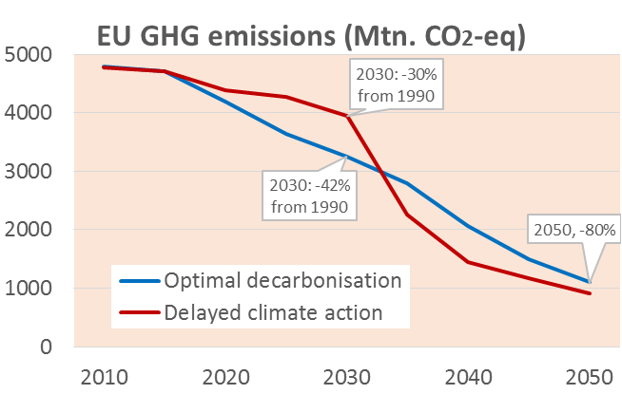
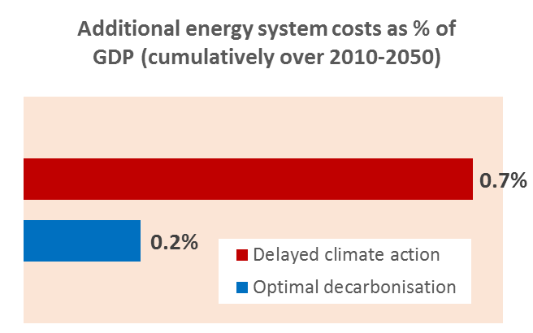
Update of the EU Energy Roadmap 2050 scenarios using multiple energy-economy models
The findings confirmed the robustness of the EU Roadmap’s priorities and conclusions:
Carbon-free electricity
Acceleration of energy efficiency
High RES deployment
Electrification of transport and stationary energy demand
Low energy system and GDP costs if all mitigation options available, including nuclear and CCS
Delayed climate action until 2030 increases costs of decarbonisation:
Higher abatement efforts after 2030
Lock-ins in the energy sector and lack of infrastructure
Delays in learning progress for RES, CCS, batteries, etc.
The findings suggest a 40% GHG reduction in EU emissions by 2030 as a cost-effective milestone

Slide 5
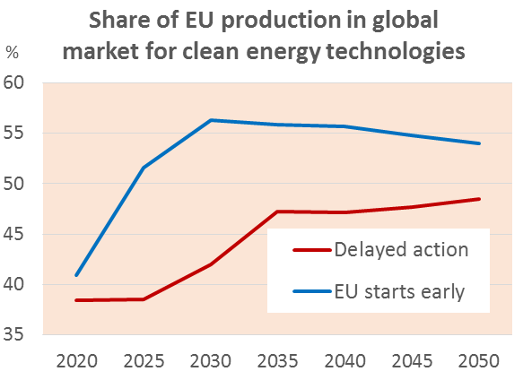
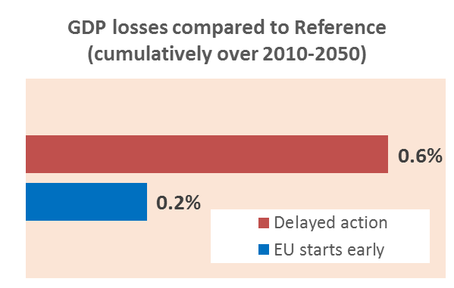
Update of the EU Energy Roadmap 2050 scenarios using multiple energy-economy models
Decarbonisation in the EU replaces imported fossil fuels by domestically produced goods and services
Europe is sufficiently large to allow for achieving a large part of the learning potential
Assuming that RoW will join climate effort by 2030, Europe can get economic benefits from earlier and unilateral climate action until 2030:
Competitive advantage and increase in exports of clean energy technologies
Electric vehicles, CCS and RES are among the winners in EU exports
Lower compliance costs because of prolonged period of restructuring
If the EU waits until 2030 to synchronise climate actions with RoW, cumulative decarbonisation costs increase threefold

Slide 6
Detailed findings

Slide 7
Objectives of the EU Analysis
Re‐quantify the Energy Roadmap 2050 decarbonisation scenarios using a variety of models
Quantify decarbonisation scenarios assuming failures in some of the low carbon technologies (nuclear and CCS)
Quantify impacts of delays during the 2020‐2030 decade in developing climate action policy
Analyse sectoral economic impacts for Europe in case of strong climate action
Assess macroeconomic implications of the EU acting unilaterally: what about leakages and could it be a first‐mover advantage?

Slide 8
Participating Models
PRIMES (EU)
Energy system model (multi-agent market equilibrium)
NEMESIS
Macroeconomic-NeoKeynesian (up to 2030)
WorldScan (Global and EU specific)
Macro-economic (General equilibrium)
TIMES-PanEU (EU)
Green-X (EU)
GEM-E3 (Global and EU specific)
Macro-economic (General equilibrium)
RES deployment
Energy system model (overall optimization)
GAINS (EU)
Non-CO2 GHG emissions

Slide 9
Key Messages from AMPERE analysis for Europe
The European Union’s long-term decarbonisation strategy requires strong 2030 climate targets
Carbon-free electricity, energy efficiency and transport electrification are critical for the decarbonisation of the EU energy system
Climate policies create opportunities for some European sectors and challenges for others
If other world regions start decarbonizing later, Europe would gain a technological first mover advantage

Slide 10
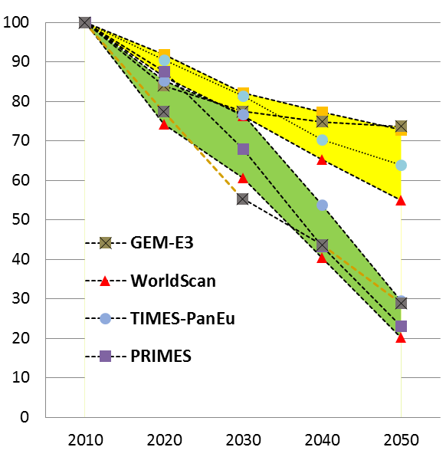
EU GHG Emissions – 2030 Targets
The Reference scenario leads to only 40% GHG emissions reductions by 2050
This is not consistent with the 2ºC global mitigation target
The EU decarbonisation pathway achieves 80% reduction in GHG emissions by 2050
The AMPERE findings suggest a 40% GHG reduction in EU emissions by 2030 as a cost-effective milestone for long term decarbonisation
Successful implementation of the EU Roadmap requires a clear signal for clean energy investments
Models confirm that both RES penetration and energy efficiency progress must accelerate considerably beyond the 2020 commitment.
The EU ETS cap reduction has to accelerate faster than the current stipulation of 1.74% per year
EU GHG emissions (index, 2010=100)
Yellow: Reference
Green: Decarbonisation

Slide 11
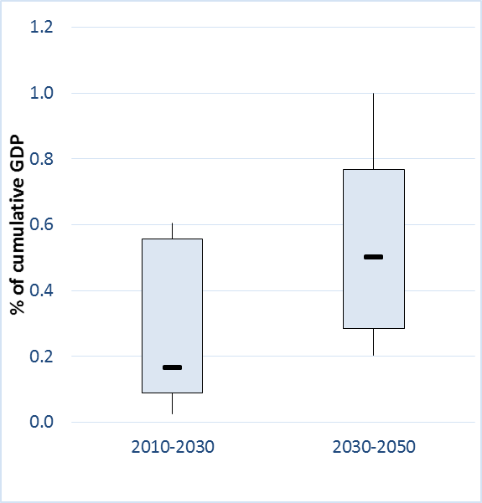
Decarbonisation costs for Europe are low if all mitigation options are available
EU decarbonisation costs compared to Reference (as % of GDP)
Box plots show the range and distribution of model results, with the black line indicating the median
Increasing the stringency of European policy to 40% reductions by 2030 from the reference pathway (which projects 30% reductions by 2030) can be achieved at moderate costs if the full range of mitigation options is available
Costs are higher after 2030 due to
stronger GHG reduction effort
exhaustion of abatement potential
higher carbon prices
GDP impacts according to macroeconomic models are higher than energy costs as % of GDP calculated by energy system models; this is mainly due to depressive effects of global climate action on global economy

Slide 12
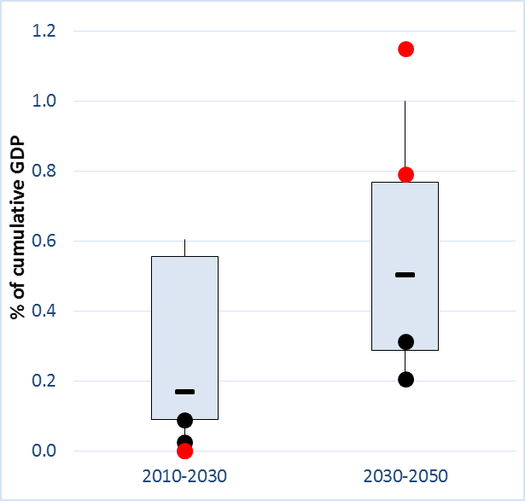
…but costs increase if climate action is delayed until 2030 and accelerates post 2030
EU decarbonisation costs compared to Reference (as % of GDP)
Black dots show costs for optimal decarbonisation Red dots show costs for delayed action until 2030
Delaying strong climate action until 2030:
implies a very steep reduction pathway after 2030
stresses the system capabilities for decarbonisation
Increased renovation rates of buildings and higher deployment of RES and CCS
PRIMES and TIMES-PanEU show that delayed climate action leads to an increase in cumulative 2010-2050 energy system costs (by 0.4-0.6 percentage points of GDP) compared to the optimal non-delaying decarbonisation scenario as a result of:
higher abatement efforts after 2030
Lock-ins in the energy sector and lack of infrastructure
Delays in learning progress for RES, CCS, batteries, etc.

Slide 13
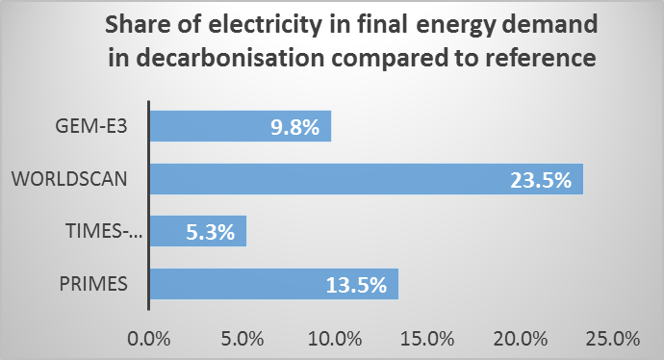
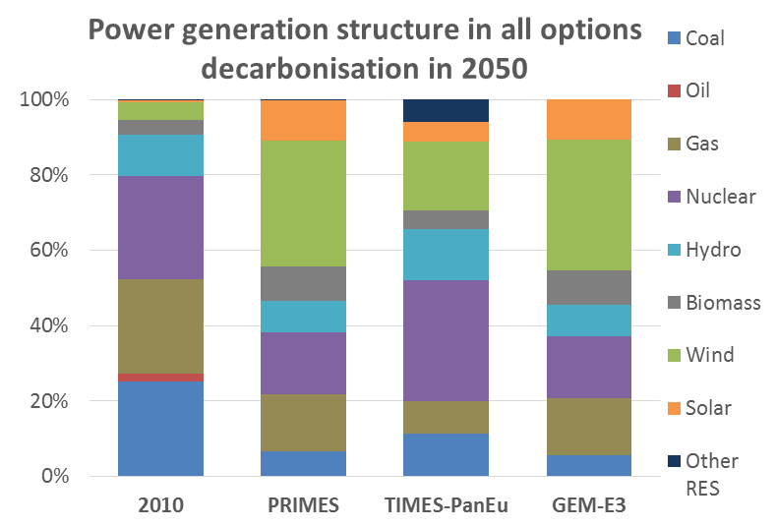
Carbon-free electricity is critical for decarbonisation
All models confirm that decarbonizing power generation and allowing electricity to substitute fossils in inflexible final demand sectors is a cost-efficient strategy
Carbon-free electricity can be supplied by a range of options:
PRIMES and GEM-E3 show high RES deployment combined with storage and gas-fired capacity
TIMES shows higher nuclear to the detriment of RES
All models show that CCS technologies have to be deployed after 2030

Slide 14
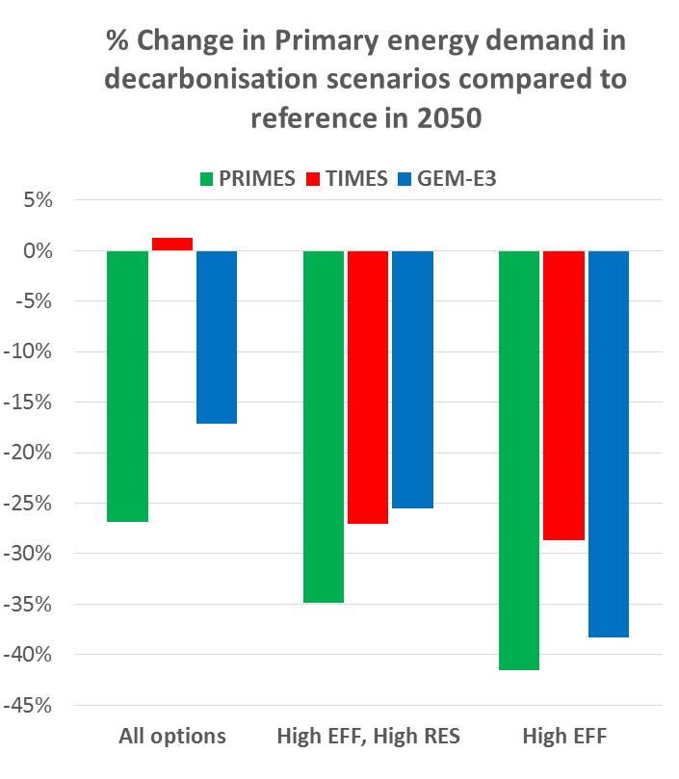
Energy efficiency progress is important
Energy efficiency is critical for decarbonisation:
Lower energy demand and CO2 emissions
Less scope for deployment of supply options (RES, CCS and nuclear)
Primary energy demand can be reduced by 40% relative to reference in 2050
The efficiency promoting decarbonisation scenario implies strong decoupling of final energy demand from GDP growth
Final energy intensity of GDP is reduced by 70% (model median) in the period 2010-2050

Slide 15
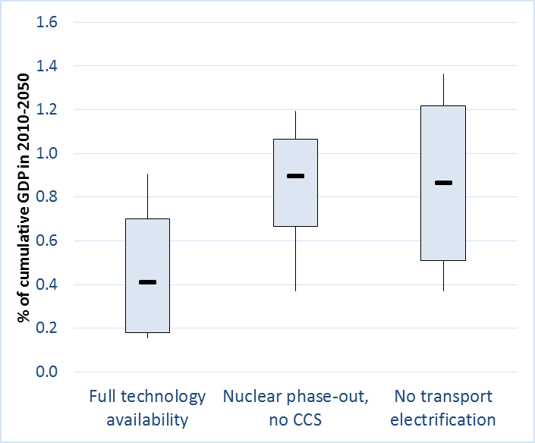
Technological limitations increase decarbonisation costs for Europe
EU decarbonisation costs compared to Reference (as % of GDP 2010-2050)
Box plots show the range and distribution of model results, with the black line indicating the median
Whether European policies preclude certain technological options has a large impact on mitigation costs.
Non-availability of nuclear and CCS leads to an increase in mitigation costs, as RES and energy efficiency options have to be used at levels with higher marginal costs
A large part of costs will be incurred for storage, grids and power system balancing due to the massive penetration of intermittent RES
Delays in transport electrification increase mitigation costs
Higher CO2 reductions in other sectors
Massive deployment of biofuels stressing biomass supply

Slide 16
Climate policies create opportunities for some European sectors and challenges for others
Decarbonisation in the EU replaces imported fossil fuels by domestically produced goods and services that are used to improve energy efficiency, electrify mobility and implement RES and other emission reduction technologies
Strong climate policies lead to a reduction of European dependence on imported oil and natural gas and enhance security of energy supply for Europe.
Higher energy costs arising from the imposition of climate policies tend to increase production costs, reduce demand and imply lower growth of overall economic activity
The reduction is more pronounced in sectors that are directly affected by higher energy costs, such as energy-intensive industries
Decarbonisation increases output and employment in energy efficiency services, equipment goods and in the agricultural sector due to higher demand for bioenergy
Employment impacts can be positive if carbon revenues are redistributed to reduce labour costs (double dividend assertion)

Slide 17
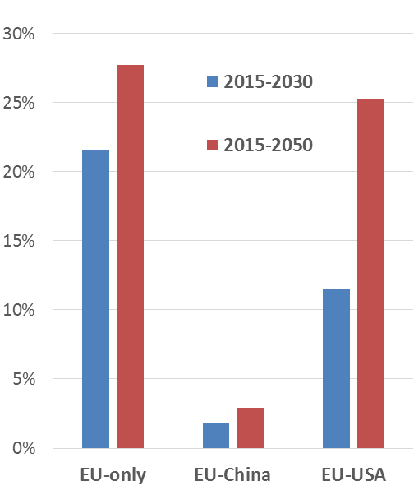
Assessment of carbon leakage through the industry channel (GEM-E3 results)
Carbon leakage when EU acts alone is around 28%
The size of the emission group and its composition (in terms of GHG and energy intensities) matters for carbon leakage: leakage is reduced to 3% when China joins the EU GHG mitigation action.
The difference in leakage rates is attributed to the carbon intensity production structure of the different countries.
The metals and chemicals sectors present the highest leakage rates, as they are characterized by both high energy intensity and high trade openness.
Leakage rates are sensitive to the assumed elasticity values in foreign trade
If carbon revenues are transferred (as subsidies) to the energy-intensive industries, carbon leakage can be reduced to half
Carbon Leakage in case of unilateral EU action and in case that China or USA join the climate effort

Slide 18
Can the EU economy get First Mover Advantage from pioneering strong climate action?
First mover advantage is meant as the possible trade and growth benefits stemming from technological leadership in technologies required to implement transition to a low carbon emitting economy
Clean energy technologies (electric vehicles, CCS, wind, photovoltaics, biofuels and energy efficient equipment) have a large potential of cost reduction if developed at a large scale.
GEM-E3 and NEMESIS include endogenous learning
as a result of increased R&D and economies of scale in mass production (learning by doing)
It is assumed that the European internal market is sufficiently large to allow for achieving a large part of learning potential for clean energy technologies

Slide 19
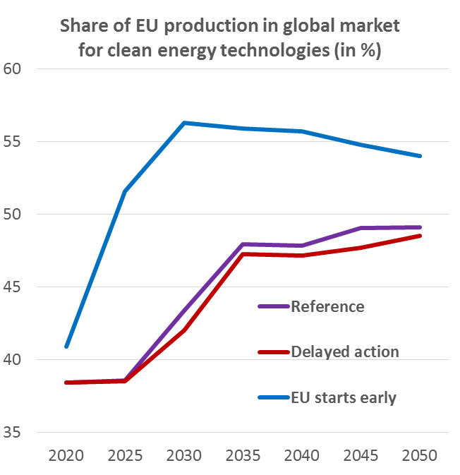
If other world regions start decarbonizing later, Europe would gain a technological first mover advantage
The learning achieved by the EU as the first mover provides cost advantages which allow leadership in global markets
the diffusion of technology worldwide diminishes the advantages over time
Electric vehicles is the main winner in European exports
Very large potential world market in case of global mitigation
EU already enjoys a comparative advantage in vehicle construction
CCS and RES technologies are also important

Slide 20
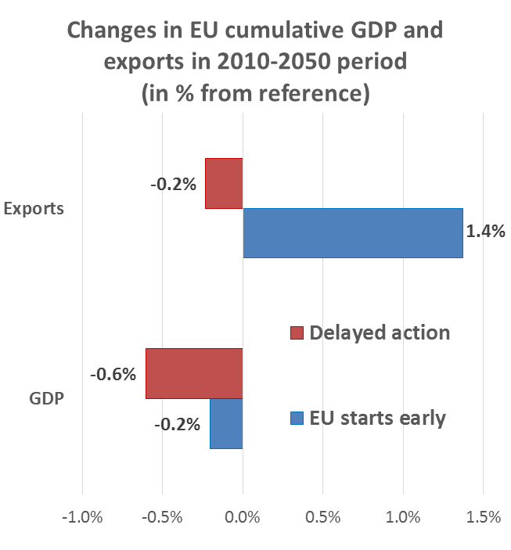
Macro-economic implications of first mover EU action
Delaying climate action until 2030 leads to a 0.6% cumulative GDP reduction in EU compared to reference
Strong EU climate effort after 2030 in order to comply with overall carbon budget
Depressive effect of mitigation action on global GDP (lower demand for EU exports)
If the EU undertakes early action and RoW joins it after 2030 the cumulative cost for EU decreases to only 0.2%
EU exports increase by 1.4% cumulatively from reference
Clean energy technologies
Prolonged period for restructuring of the EU energy system

Slide 21
Conclusions
The AMPERE findings confirm the robustness of the EU Roadmap’s main priorities and conclusions:
Carbon-free electricity and high RES deployment
Acceleration of energy efficiency improvements
Electrification of transport and stationary demand
Low energy system and GDP costs if all mitigation options available, including nuclear and CCS
The AMPERE analysis suggests a 40% GHG reduction in EU emissions by 2030 as a cost-effective milestone
Delayed climate action until 2030 increases considerably the cumulative decarbonisation costs
Higher abatement efforts after 2030
Lock-ins in the energy sector and lack of infrastructure
Delays in learning progress for RES, CCS, batteries, etc.
Assuming that RoW will join the EU effort by 2030, Europe can get economic benefits from early action until 2030:
Competitive advantage and increase in exports of clean energy technologies (mainly electric vehicles, CCS and RES)
Prolonged period for the restructuring of the energy system

Slide 22
AMPERE papers on EU decarbonisation: (Energy Strategy Reviews, vol 2, issue 3/4, 2014)
Capros et al. European decarbonisation pathways under alternative technological and policy choices: A multi-model analysis
Capros et al. Description of models and scenarios used to assess European decarbonisation pathways

Slide 23
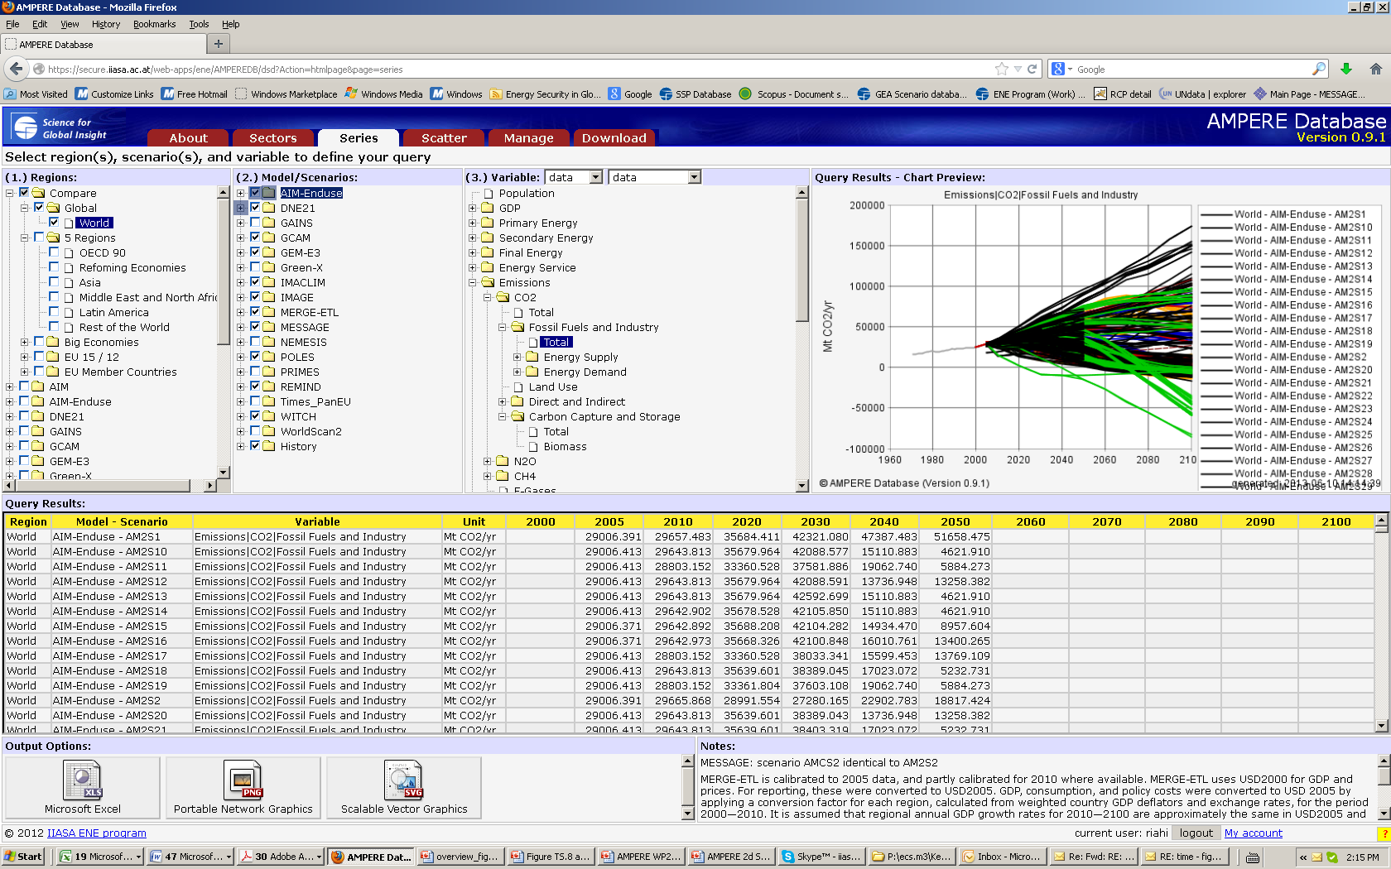
AMPERE Scenarios Database https://secure.iiasa.ac.at/web-apps/ene/AMPEREDB/

Slide 24
Thank You
More information on AMPERE: ampere-project.eu

